Slide 1
Inter-Domain Routing
Lecture X
CS 168, Fall 2024 @ UC Berkeley
Slides credit: Sylvia Ratnasamy, Rob Shakir, Peyrin Kao
Notes:
Slides template credit: Josh Hug, Lisa Yan

Slide 2
Autonomous Systems
Autonomous Systems
What are ASes?
Business Relationships
Goals of Inter-Domain Routing
Policy-Based Routing
Gao-Rexford Rules
BGP (Border Gateway Protocol)
Importing and Exporting
Aggregation and Path-Vector
Lecture X, CS 168, Fall 2024

Slide 3
Intra-Domain vs. Inter-Domain Routing
Recall: The Internet is a network of networks.
We used intra-domain routing to compute routes inside each network.

Slide 4
Intra-Domain vs. Inter-Domain Routing
Today's focus is inter-domain routing: finding paths between networks.
We'll bring back the individual routers next time.

Slide 5
Autonomous Systems
Autonomous System (AS): One or more local networks, all under a single administrative control.
Example: UC Berkeley's AS might contain both CalVisitor and eduroam.
Sometimes informally called "domains."
Each AS is assigned a unique AS number (ASN).
Example: UC Berkeley is ASN 25.

Slide 6
AS Graph
Inter-domain topology (or AS graph): A graph of ASes, with the individual routers and hosts abstracted away. Each node is an AS.

Slide 7
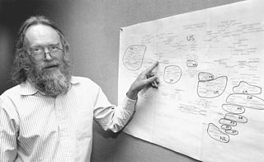
Brief History of Autonomous Systems
Who assigns new ASNs?
In the early days: Some guy.
Today: Internet Assigned Numbers Authority (IANA).
Jon Postel (1943–1998)
Notes:
https://commons.wikimedia.org/wiki/File:Jon_Postel_(full_frame).jpg

Slide 8
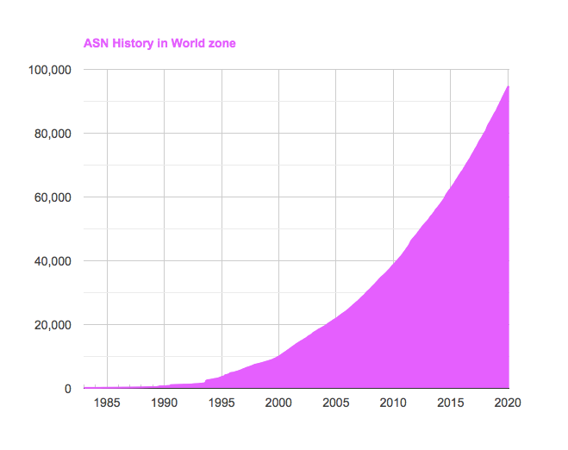
Brief History of Autonomous Systems
Number of ASes increases over time: Over 90,000 today!

Slide 9
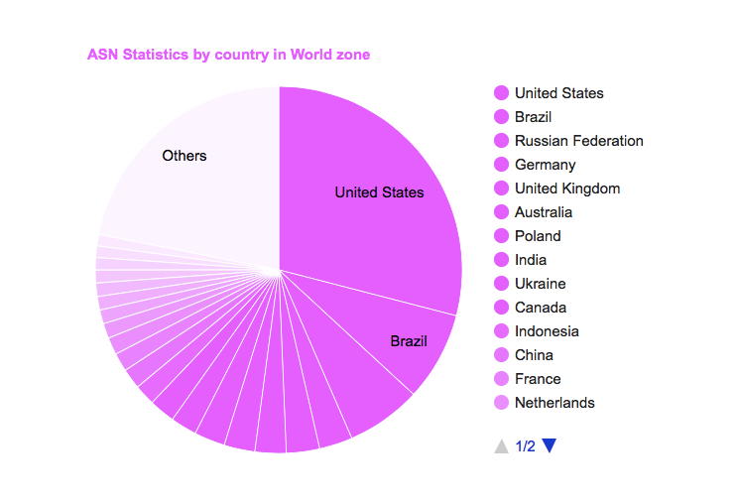
Brief History of Autonomous Systems
ASes by country: USA has the most, followed by Brazil.

Slide 10
Types of Autonomous Systems
Stub AS: Only sends/receives packets on behalf of hosts inside the AS.
Similar to end hosts in intra-domain model.
Does not forward packets between other ASes.
Examples: UC Berkeley, local bank.
Most ASes are this type.
Transit AS: Forwards packets on behalf of other ASes.
Similar to routers in intra-domain model.
Can still send/receive packets for hosts inside the AS.
Examples: AT&T, Verizon.
Can vary in scale (global, regional).
Note: Some modern ASes (e.g. Google, Amazon) blur the line between stub and transit, but we won't worry about them.

Slide 11
Business Relationships
Autonomous Systems
What are ASes?
Business Relationships
Goals of Inter-Domain Routing
Policy-Based Routing
Gao-Rexford Rules
BGP (Border Gateway Protocol)
Importing and Exporting
Aggregation and Path-Vector
Lecture X, CS 168, Fall 2024

Slide 12
Business Relationships
Inter-domain topology is shaped between business relationships between ASes.
Two different ways for a pair of ASes to be related:
Customer-provider relationship:
The customer pays the provider.
In exchange, the provider offers to forward traffic to/from the customer.
Peering relationship:
Peers don't pay each other.
Peers exchange roughly equal traffic.

Slide 13
AS Graph with Business Relationships
Representing business relationships in the AS graph:
Provider Customer
Peer Peer
The arrows do not represent direction of packets (e.g. F can send packets to C).
A
B
C
D
E
F
G
H

Slide 14
AS Graph with Business Relationships
Stub ASes in this graph: F, G, H.
No outgoing edges: Not providing service to anybody.
Incoming edge(s) shows who they're buying service from.
A
B
C
D
E
F
G
H

Slide 15
AS Graph with Business Relationships
Transit ASes in this graph: A, B, C, D, E.
Outgoing edges indicate they're providing service to somebody.
A
B
C
D
E
F
G
H

Slide 16
AS Graph is Acyclic
The AS graph has no cycles.
A cycle means you're paying yourself, which doesn't make sense.
A cycle of peering relationships is okay.
A
A
B
C
B
C
Invalid
Valid

Slide 17
Provider Hierarchy
The AS graph forms a hierarchy (all arrows point down).
Service flows down: Higher nodes provide service to lower nodes.
Money flows up: Lower nodes pay money to higher nodes.
A
B
C
D
E
F
G
H

Slide 18
Tier 1 ASes
Tier 1 ASes: ASes at the top of the hierarchy.
A Tier 1 AS:
Has no providers (no incoming edges).
Has a peering relationship with every other Tier 1 AS.
This helps ensure the AS graph is connected (no disconnected components).
A
B
C

Slide 19
Tier 1 ASes
Tier 1 ASes: ASes at the top of the hierarchy.
~20 Tier 1 ASes in real life.
USA: AT&T, Verizon
Europe: Telecom Italia, France Telecom
Asia: NTT Communications (Japan)
These companies usually own infrastructure spanning the whole world.

Slide 20
Properties of AS Graphs
Every non-Tier 1 AS has at least one provider (incoming edge).
Starting at any AS and walking up the graph will eventually lead to a Tier 1 AS.
A
B
C
D
E
F
G
H

Slide 21
Goals of Inter-Domain Routing: Policy-Based Routing
Autonomous Systems
What are ASes?
Business Relationships
Goals of Inter-Domain Routing
Policy-Based Routing
Gao-Rexford Rules
BGP (Border Gateway Protocol)
Importing and Exporting
Aggregation and Path-Vector
Lecture X, CS 168, Fall 2024

Slide 22
Goals of Inter-Domain Routing
Scalability: Routing must scale to the entire Internet.
Solution: Hierarchical IP addressing.
Privacy: ASes don't want to explicitly announce sensitive information.
I shouldn't have to tell everybody who my provider is.
Companies might not want to reveal information to rivals.
"Explicitly" - Some minor leakage is inevitable.
Autonomy: ASes want the freedom to choose their own policies.
Policy is usually based on business goals.

Slide 23
Policy-Based Routing
Autonomy: ASes want the freedom to choose their own policies.
Recall our routing goals:
Valid paths:
Intra-domain definition: No loops, no dead ends.
Inter-domain definition: Same.
Good paths:
Intra-domain definition: Least-cost paths.
Inter-domain definitions: Paths that respect every AS's policies.

Slide 24
Policy-Based Routing
Autonomy: ASes want the freedom to choose their own policies.
Examples of policies:
Define how I will handle traffic from others:
I don't want to carry AS#2046's traffic through my network.
Defines how others should handle my traffic:
I prefer if my traffic was carried by AS#10 instead of AS#4.
Don't send my traffic through AS#54 unless absolutely necessary.
More exotic policies:
I prefer AS#12 on weekdays, and AS#13 on weekends.
We have to find paths that respect every AS's policies.

Slide 25
Gao-Rexford Rules
Autonomous Systems
What are ASes?
Business Relationships
Goals of Inter-Domain Routing
Policy-Based Routing
Gao-Rexford Rules
BGP (Border Gateway Protocol)
Importing and Exporting
Aggregation and Path-Vector
Lecture X, CS 168, Fall 2024

Slide 26


Gao-Rexford Rules
In theory, ASes can set any weird policy they want.
In practice, most ASes follow standard conventions: Gao-Rexford Rules.
These conventions reflect real-world business practices:
Making money is good.
Don't do work for free.
Lixin Gao and Jennifer Rexford surveyed various ASes to come up with these rules.

Slide 27
Gao-Rexford Rules: Choosing Routes
Distance-vector protocol: Prefer the shortest path.
Gao-Rexford rules: Prefer the most profitable path.
Best: Path where the next hop is a customer. (They pay me.)
Less good: Path where the next hop is a peer. (I don't make money.)
Worst: Path where the next hop is a provider. (I have to pay.)
Reflects real-world business practice: Making money is good.

Slide 28
Gao-Rexford Rules: Choosing Routes
Gao-Rexford rules: If I'm offered multiple paths, pick the most profitable one.
A (Provider)
I prefer the path via C, because C will pay me to forward packets.
S
B (Peer)
D
C (Customer)

Slide 29
Gao-Rexford Rules: Choosing Routes
Gao-Rexford rules: If I'm offered multiple paths, pick the most profitable one.
A (Provider)
I prefer the path via B. I don't make money, but at least I don't have to pay.
S
B (Peer)
D
C

Slide 30
Gao-Rexford Rules: Participating in Routes
Distance-vector protocol: I am okay with participating in any route.
"Participating": Being one of the routers forwarding packets along a path.
Gao-Rexford rules: I will only participate in routes where I get paid.
Reflects real-world business relationship: Don't do work for free.
How to check if I get paid:
Look at my two neighbors along the path.
I get paid if and only if one of my neighbors is a customer.

Slide 31
Gao-Rexford Rules: Participating in Routes
I get paid and participate if and only if at least one of my neighbors is a customer.
A and C are both paying me. I'm gonna be rich!!
✓
B
B agrees to participate
A (Customer)
C (Customer)
Packet forwarded via A → B → C

Slide 32
Gao-Rexford Rules: Participating in Routes
I get paid and participate if and only if at least one of my neighbors is a customer.
A is not paying me, but at least C is paying me.
✓
A (Peer)
B
B agrees to participate
C (Customer)
Packet forwarded via A → B → C

Slide 33
Gao-Rexford Rules: Participating in Routes
I get paid and participate if and only if at least one of my neighbors is a customer.
In this scenario: I get paid by C, but I have to pay A.
I should still participate because this is how I offer service to my customers.
A (Provider)
I'm getting paid by C. I might have to send some of it to A but that's okay.
✓
B
B agrees to participate
C (Customer)
Packet forwarded via A → B → C

Slide 34
Gao-Rexford Rules: Participating in Routes
I get paid and participate if and only if at least one of my neighbors is a customer.
Peers do not provide transit between other peers.
Nobody is paying me to do this. I won't participate.
✗
A (Peer)
B
C (Peer)
B refuses to participate
Packet forwarded via A → B → C

Slide 35
Gao-Rexford Rules: Participating in Routes
I get paid and participate if and only if at least one of my neighbors is a customer.
If one of my neighbors is a peer, the other neighbor must be a customer.
An AS only carries traffic to/from its own customers over a peering link.
A (Provider)
I have to pay A, and I am not paid by C. No thanks.
✗
B
C (Peer)
B refuses to participate
Packet forwarded via A → B → C

Slide 36
Gao-Rexford Rules: Participating in Routes
I get paid and participate if and only if at least one of my neighbors is a customer.
Routes are valley-free.
Travelling downhill, and turning around and going back uphill is not allowed.
A (Provider)
C (Provider)
✗
B
B refuses to participate
I have to pay both A and C. Only a fool would participate.
Packet forwarded via A → B → C

Slide 37
Policy-Based Routing Example
D and E want to exchange traffic along this path.
Will the transit ASes (A, B, C) agree to participate?
A
B
C
D
E

Slide 38
Policy-Based Routing Example
D and E want to exchange traffic along this path.
Will the transit ASes (A, B, C) agree to participate?
Yes, each transit AS has an adjacent customer.
I get paid by B and C.
A
I get paid by D.
I get paid by E.
B
C
D
E

Slide 39
Policy-Based Routing Example
Suppose we add a new link (B and C establish a peering relationship).
Will the transit ASes (B, C) agree to participate in this new route?
Yes, each transit AS has an adjacent customer.
A
I get paid by D.
I get paid by E.
B
C
D
E

Slide 40
Policy-Based Routing Example
Suppose we add a new link (B and C establish a peering relationship).
Will the transit ASes (B, C) agree to participate in this new route?
A
B
C
D
E

Slide 41
Policy-Based Routing Example
With the new link, B and C save money (they don't have to pay A anymore).
Trade-off: B and C have to pay to build that link.
A
A
B
C
B
C
D
E
D
E

Slide 42
Properties of Routes with Gao-Rexford Rules
Routes are single-peaked.
We first climb 0 or more uphill links.
Then, we reach a peak, and traverse 0 or 1 peering links.
Then, we go strictly downhill all the way to the destination.
C
D
B
E
A
F
Packet forwarded via A → B → C → D → E → F

Slide 43
Proving Reachability and Convergence with Gao-Rexford
If all of these are true:
Starting from any AS and moving up the hierarchy will lead to a Tier 1 AS.
The AS graph has no cycles.
All ASes follow the Gao-Rexford rules.
Then we can guarantee these two properties:
Reachability: Any two ASes in the graph can communicate.
Convergence: All ASes agree on paths.
These properties hold in steady-state.
Steady-state: Network topology and policies remain unchanged.
If something changes, it might take some time for ASes to reconverge.
If ASes pick arbitrary policies (not following Gao-Rexford), we can't guarantee these properties.

Slide 44
Summary: Autonomous Systems, Policy-Based Routing
AS topology reflects business relationships between ASes.
Business relationships impact what routes are chosen, and what routes are acceptable.
Inter-domain routing design must support:
Scalability
Autonomy (support policy choices)
Privacy

Slide 45
BGP: Importing and Exporting
Autonomous Systems
What are ASes?
Business Relationships
Goals of Inter-Domain Routing
Policy-Based Routing
Gao-Rexford Rules
BGP (Border Gateway Protocol)
Importing and Exporting
Aggregation and Path-Vector
Lecture X, CS 168, Fall 2024

Slide 46
A Brief History of BGP
Least-cost routing algorithms are based on old ideas.
Shortest-path algorithms predate the Internet: Dijkstra's (1956), Bellman-Ford (1958).
Autonomous systems grew out of necessity.
Internet control transferred from the US government to various companies.
The Internet grew too big for least-cost routing algorithms.
Autonomous systems were a new idea to computer science.
No precedent for "find paths according to business policy."
Ideas behind BGP were developed on the fly (1989–1995).
It's not perfect, but it's stood the test of time.
BGP is the one and only inter-domain routing protocol in use.
Remember: Everyone must agree on the same one.

Slide 47
Starting Point: Distance-Vector or Link-State?
Distance-vector or link-state: Which would be a better starting point?
Link-state is a bad choice.
No privacy: I have to reveal my policies to everybody else.
No autonomy: Everyone has to agree on a metric (e.g. least-cost) for consistency.
Distance-vector is a better choice.
BGP extends distance-vector to accommodate policy.
BGP and distance-vector are similar:
Advertisements are specific to one destination (i.e. one prefix).
No global sharing of network topology.
Iterative and distributed convergence on paths.

Slide 48
Importing and Exporting Paths
New terminology for old ideas:
Advertise (export) the best route to one or more of your neighbors.
Select (import) the best route you hear about.
Use policy to decide which route to import, and who to export routes to.

Slide 49
Importing Paths
Gao-Rexford import policy: Pick the route advertised by customer > provider > peer.
Contrast with distance-vector: Pick the shortest route.
Import decision determines where an AS sends its outbound traffic.
Why? Because this involves choosing a route.
A (Provider)
I prefer the path via C, because C will pay me to forward packets.
"I can reach D."
S
"I can reach D."
B (Peer)
D
"I can reach D."
C (Customer)
Packets for D get forwarded this way.

Slide 50
Exporting Paths
Gao-Rexford export policy: I only export a route if participating in it makes me money.
Contrast with distance-vector: Advertise a route to all neighbors.
Export decision determines what traffic an AS will carry.
Why? Advertising a route means I'm letting others forward traffic through me.
A (Provider)
I have a route to D, but should I tell A, B, C about it?
B (Peer)
S
D
C (Customer)
Packets for D get forwarded this way.

Slide 51
Exporting Paths From Customers
Gao-Rexford export policy: I only export a route if participating in it makes me money.
If I receive a route from a customer, export it to everybody.
The resulting route will be profitable: There's a customer on one end.
A (Provider)
All three of these routes make me money.
B (Peer)
S
D (Customer)
C (Customer)
Packets for D get forwarded this way.

Slide 52
Exporting Paths From Customers
Gao-Rexford export policy: I only export a route if participating in it makes me money.
If I receive a route from a customer, export it to everybody.
The resulting route will be profitable: There's a customer on one end.
A (Provider)
I'll tell everyone about this route.
"I can reach D."
B (Peer)
"I can reach D."
S
D (Customer)
"I can reach D."
C (Customer)
Packets for D get forwarded this way.

Slide 53
Exporting Paths From Peers
Gao-Rexford export policy: I only export a route if participating in it makes me money.
If I receive a route from a peer, only export it to a customer.
The peer isn't paying, so I only profit if the person on the other end is a customer.
A (Provider)
Only the green route makes me money.
B (Peer)
S
D (Peer)
C (Customer)
Packets for D get forwarded this way.

Slide 54
Exporting Paths From Peers
Gao-Rexford export policy: I only export a route if participating in it makes me money.
If I receive a route from a peer, only export it to a customer.
The peer isn't paying, so I only profit if the person on the other end is a customer.
A (Provider)
I'll only tell C about this route.
B (Peer)
S
D (Peer)
"I can reach D."
C (Customer)
Packets for D get forwarded this way.

Slide 55
Exporting Paths From Providers
Gao-Rexford export policy: I only export a route if participating in it makes me money.
If I receive a route from a provider, only export it to a customer.
I pay the provider, so I only profit if the person on the other end is a customer.
A (Provider)
Only the green route makes me money.
B (Peer)
S
D (Provider)
C (Customer)
Packets for D get forwarded this way.

Slide 56
Exporting Paths From Providers
Gao-Rexford export policy: I only export a route if participating in it makes me money.
If I receive a route from a provider, only export it to a customer.
I pay the provider, so I only profit if the person on the other end is a customer.
A (Provider)
I'll only tell C about this route.
B (Peer)
S
D (Provider)
"I can reach D."
C (Customer)
Packets for D get forwarded this way.

Slide 57
Exporting Paths From Providers
Gao-Rexford export policy: I only export a route if participating in it makes me money.
Key idea: The route needs a customer on at least one side.
If a customer advertised the route, we already have a customer on one side. The other side can be anybody.
If a peer/provider advertised the route, we're still missing a customer. The other side must be a customer.
Route advertised by... | Export route to...
Customer | Everyone (providers, peers, customers)
Peer | Customers only
Provider | Customers only

Slide 58
BGP: Aggregation and Path-Vector
Autonomous Systems
What are ASes?
Business Relationships
Goals of Inter-Domain Routing
Policy-Based Routing
Gao-Rexford Rules
BGP (Border Gateway Protocol)
Importing and Exporting
Aggregation and Path-Vector
Lecture X, CS 168, Fall 2024

Slide 59
Modifications from Distance-Vector to BGP
Changes we've made so far:
Import paths based on policy (e.g. prefer customer > peer > provider), instead of based on least-cost.
Export paths based on policy (e.g. only advertise profitable routes), instead of advertising all routes.
We need to make two more changes:
Aggregating prefixes for scalability.
Changing from distance-vector to path-vector.

Slide 60
Modification #1: Aggregating Prefixes
Recall: For scalability, each forwarding table entry maps a range of IPs to a next hop.
Each AS is addressed by a prefix (all machines inside the AS share the same prefix).
BGP can aggregate multiple entries into one, combining ranges into one larger range.
Destination Prefix | Next hop
12.1.0.0/16 | Physical port #1
12.2.0.0/16 | Physical port #1
12.3.0.0/16 | Physical port #1
Destination Prefix | Next hop
12.0.0.0/8 | Physical port #1

Slide 61
Modification #1: Aggregating Prefixes
Recall: Aggregation scales because addresses are hierarchical.
Multi-homing: An AS having multiple providers.
Multi-homing limits aggregation.
4.0.0.0/8 is this way.
Verizon
AT&T
4.0.0.0/8
4.24.0.0/16 is this way.
UCB
4.24.0.0/16
UCLA
4.78.0.0/16
UCSF
4.91.0.0/16

Slide 62
Modification #2: Distance-Vector → Path-Vector
Problems with distance-vector-based BGP:
There might be loops.
Least-cost routing guaranteed no loops.
Switching to policy-based routing caused us to lose that guarantee.
We can support Gao-Rexford rules, but not arbitrary policies.
Suppose my policy is: "My traffic should never pass through AS#2019.
I get an announcement: "I am AS#20 and I can reach D with cost 10.
How do I know if this route satisfies my policy?
B
C
B's policy: "I like sending packets via C."
C's policy: "I like sending packets via B."

Slide 63
Modification #2: Distance-Vector → Path-Vector
Solution: Change from distance-vector to path-vector.
Instead of advertising distance to destination, advertise the whole AS path.
Example: "I am A, and I have a path to D via A → B → C → D."
This solves both of our problems.
Loop detection: Check if adding myself to the path creates a loop.
If I'm C, adding myself to the path creates a cycle: C → A → B → C → D.
If the path has a cycle (after adding myself), reject the advertisement.
Arbitrary policies: The entire path is available for checking against policy.
If my policy is "don't send my packets through B," I can check the path and reject the advertisement.

Slide 64
Stub ASes Use Default Routes
If a stub AS is connected to a single provider, it doesn't need to run BGP.
The stub AS default-routes everything to the provider.
The provider advertises that they can reach the stub AS's prefix.
The provider is advertising on behalf of the stub.
Forwarding table:
Send stub packets ↓ this way ↓
Provider
Forwarding table:
Send everything to provider.
Stub

Slide 65
Summary: Inter-Domain Routing
In the AS graph, edges reflect physical connections and business relationships.
Customers pay providers.
Peres don't pay each other.
Paths are selected based on policy.
Policy (e.g. Gao-Rexford rules) reflects business goals.
Making money is good.
Don't do work for free.
Good stuff (reachability, converge) happens if you follow Gao-Rexford rules.
BGP extends distance-vector to implement inter-domain routing.
Destinations are IP prefixes that can be aggregated.
Each AS advertises its path to a prefix.
Policy dictates which paths an AS selects (import policy), and which paths it advertises (export policy).

